Slide 1
Checking understanding of congruence
Geometrical properties and Pythagoras’ theorem

Slide 2
how to use Oak lessons

Slide 3
I can translate, reflect and rotate a shape.

Slide 4
If one shape can fit exactly on top of another using rotation, reflection or translation, then the shapes are congruent.
The rotation of an object is the turning of an object by a fixed amount and around a fixed point (called the centre of rotation), without the image being flipped or its size changing.
An object is reflected when it is flipped over a fixed line (called the line of reflection), without the image being turned or its size changing.
Translation is a transformation in which every point of a shape moves the same distance in the same direction.
Enlargement is a transformation that causes a change of size.

Slide 5

Checking understanding of congruence
Transformations with congruence
Identifying missing information on congruent shapes

Slide 6
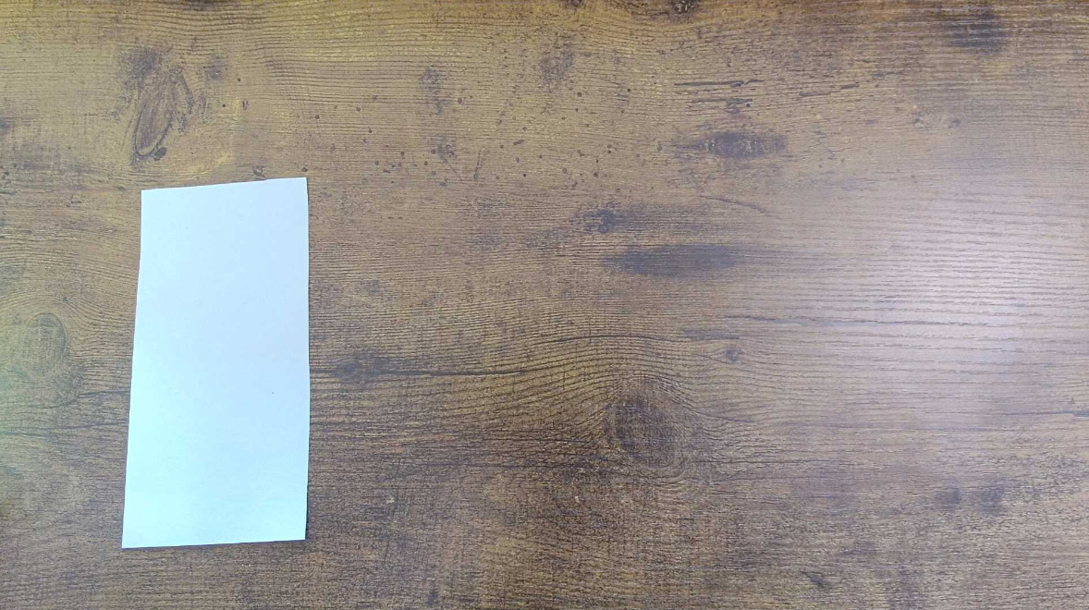
Transformations with congruence
A paper rectangle is placed on a desk. Andeep, Izzy, Jacob, Laura and Sofia discuss what they could now do with the shape.

Slide 7
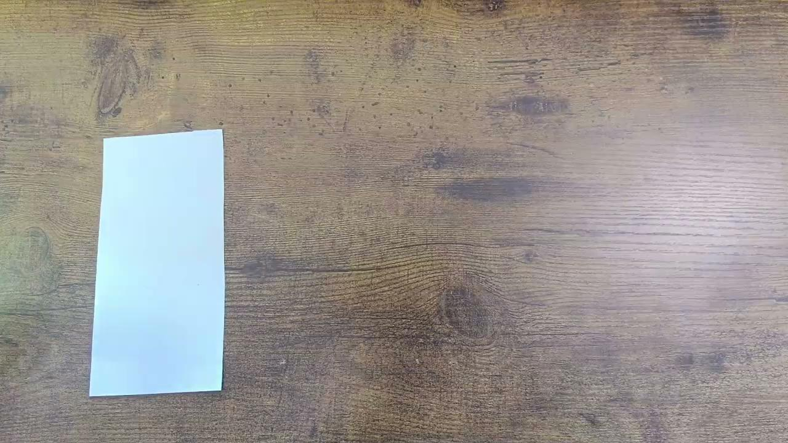
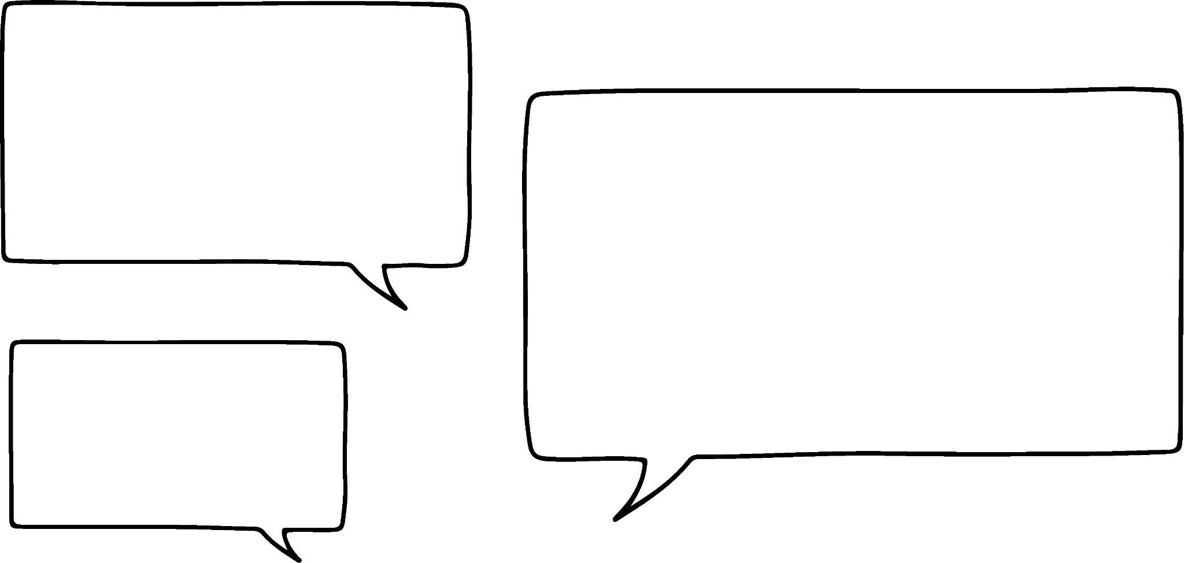

Transformations with congruence
A paper rectangle is placed on a desk. Andeep, Izzy, Jacob, Laura and Sofia discuss what they could now do with the shape.
We could move the rectangle.
This would be a translation.
Andeep

Slide 8

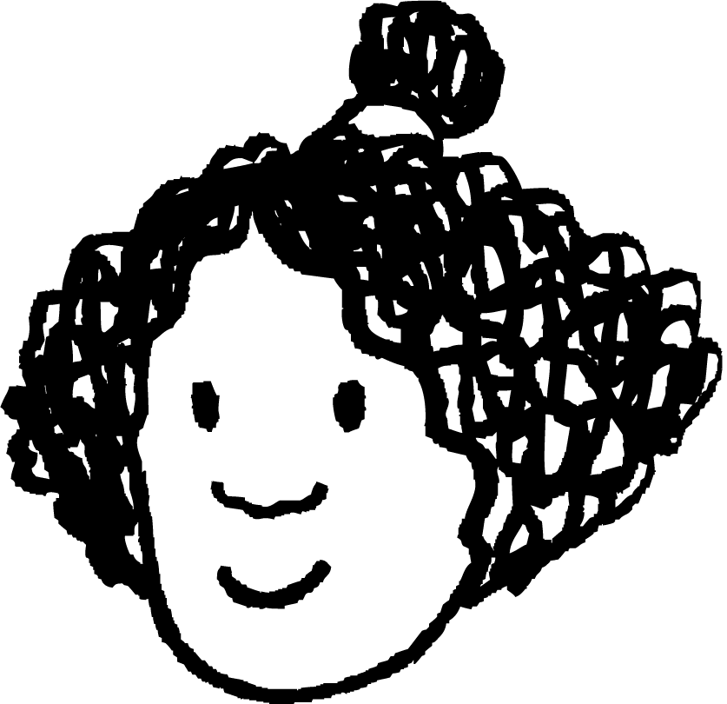
Transformations with congruence
A paper rectangle is placed on a desk. Andeep, Izzy, Jacob, Laura and Sofia discuss what they could now do with the shape.
We could flip the rectangle.
This would be a reflection.
Izzy

Slide 9


Transformations with congruence
A paper rectangle is placed on a desk. Andeep, Izzy, Jacob, Laura and Sofia discuss what they could now do with the shape.
We could turn the rectangle.
This would be a rotation.
Jacob

Slide 10
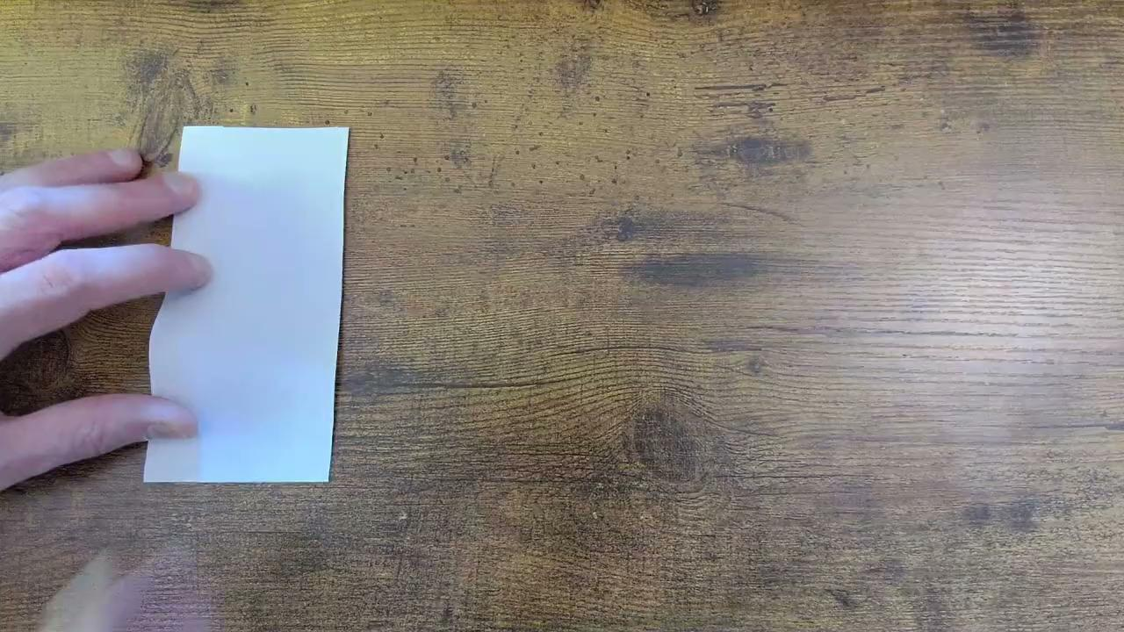

Transformations with congruence
A paper rectangle is placed on a desk. Andeep, Izzy, Jacob, Laura and Sofia discuss what they could now do with the shape.
We could cut it into a smaller similar rectangle.
This would be an enlargement.
Laura

Slide 11


Transformations with congruence
A paper rectangle is placed on a desk. Andeep, Izzy, Jacob, Laura and Sofia discuss what they could now do with the shape.
We could cut it into a different shape.
This isn’t a standard transformation.
Sofia

Slide 12

Transformations with congruence
Andeep considers what effect each action has on the shape.
translation
reflection
rotation
enlargement
change shape
Some actions change the lengths and some change the angles.
Which actions preserve both the lengths and angles?

Slide 13
Transformations with congruence
Shapes which have the same lengths and angles are congruent.
pairs of congruent shapes:
pairs of incongruent shapes:

Slide 14
Transformations with congruence
Shapes which have the same lengths and angles are congruent.
pairs of congruent shapes:
This means that translation, reflection and rotation always produce an image that is congruent to the object.
Izzy

Slide 15
Transformations with congruence
The two shapes are congruent.
3 cm
5 cm
3 cm
5 cm
The shapes have the same lengths.
The shapes have different angles.

Slide 16
Transformations with congruence
The two shapes are congruent.
3 cm
5 cm
6 cm
The shapes have the different lengths.
10 cm
The shapes have the same angles.

Slide 17
Transformations with congruence
The two shapes are congruent.
3 cm
5 cm
3 cm
The shapes have the same lengths and the same angles.
5 cm
The shapes are in different orientations.

Slide 18
Transformations with congruence
Which transformations always result in an image that is congruent to the original object?
enlargement
reflection
rotation
translation

Slide 19
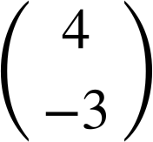
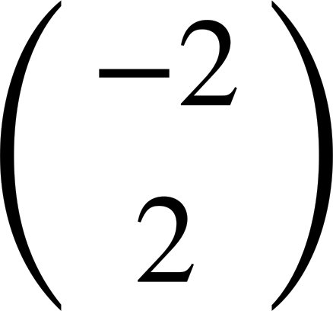

Transformations with congruence
Produce a congruent shape by translating the object by .
Produce a congruent shape by translating the object by .

Slide 20
Transformations with congruence
Produce a congruent shape by reflecting the object over the line.
Produce a congruent shape by reflecting the object over the line.

Slide 21

Transformations with congruence
Produce a congruent shape by rotating the object 90°clockwise around the point.
Produce a congruent shape by rotating the object 90°anticlockwise around the point.

Slide 22
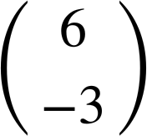
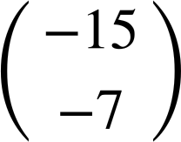
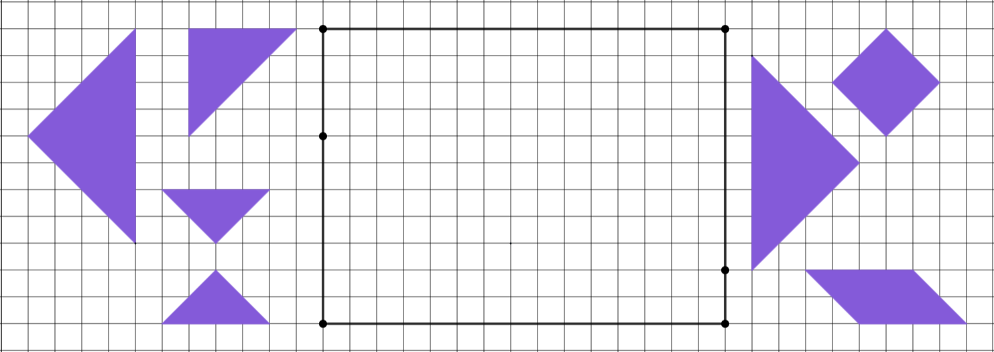
Transformations with congruence
1)
a) Reflect A over PT.
b) Rotate B 180° around U.
c) Translate C .
d) Reflect D over PT.
e) Translate E .
f) Rotate F 90° anticlockwise around R.
g) Reflect G over QS.
P
Q
B
E
A
U
F
C
R
D
G
T
S

Slide 23
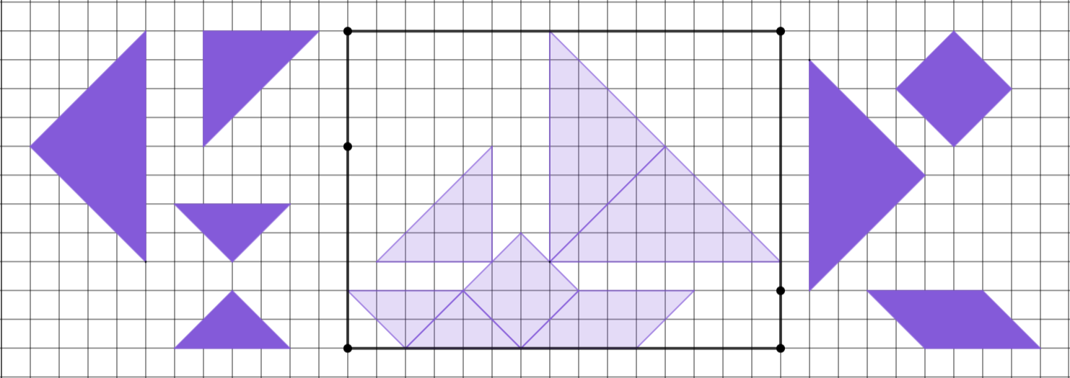
Transformations with congruence
1)
a) Reflect A over PT.
b) Rotate B 180° around U.
c) Translate C .
d) Reflect D over PT.
e) Translate E .
f) Rotate F 90° anticlockwise around R.
g) Reflect G over QS.
P
Q
B
E
A
U
F
C
R
D
G
T
S

Slide 24
Checking understanding of congruence
Transformations with congruence
Identifying missing information on congruent shapes

Slide 25
Identifying missing information on congruent shapes
Reflection, rotation and translation always produce an image that is congruent to the object.
When two shapes are congruent, their lengths and angles are the same.
The positions and orientation of the lengths and angles may differ, but they will still maintain the same order.

Slide 26
Identifying missing information on congruent shapes
Shapes A and B are congruent.
Shapes C and D are congruent.
5
5
13
67°
5
118°
118°
C
23°
17
17
15
A
15
B
12
13
67°
62°
62°
5
D
23°
13
13
12
What transformation maps A onto B?
What transformation maps C onto D?
translation
translation
Label shape B with its missing lengths and angles.
Label shape D with its missing lengths and angles.

Slide 27
Identifying missing information on congruent shapes
Shapes A and B are congruent.
Shapes C and D are congruent.
5
5
13
67°
5
118°
118°
C
23°
17
17
15
A
B
15
12
12
62°
62°
23°
D
5
13
13
67°
13
What transformation maps A onto B?
What transformation maps C onto D?
reflection
reflection
Label shape B with its missing lengths and angles.
Label shape D with its missing lengths and angles.

Slide 28
Identifying missing information on congruent shapes
Shapes A and B are congruent.
Shapes C and D are congruent.
5
15
13
67°
5
118°
5
C
B
118°
23°
17
13
15
A
12
62°
17
12
62°
23°
5
D
13
67°
13
What transformation maps A onto B?
What transformation maps C onto D?
rotation
rotation
Label shape B with its missing lengths and angles.
Label shape D with its missing lengths and angles.

Slide 29
Identifying missing information on congruent shapes
1) The five triangles are congruent.
a) What transformation maps A onto B?
37°
B
5
4
b) What transformation maps B onto C?
A
53°
c) What transformation maps C onto D?
3
C
d) What transformation maps D onto E?
E
D
e) What transformation maps E onto A?
f) Label the missing lengths and angles on triangles B to E.

Slide 30
Identifying missing information on congruent shapes
2) The four quadrilaterals are congruent. The transformations which map each shape onto the next shape are stated below.
2.99
89°
92°
3.99
A
4
B
C
D
88°
91°
3
A ↦ B: translation
B ↦ C: reflection
C ↦ D: rotation of 180°
a) Label the missing lengths and angles on shapes B to D.
b) Which transformation could be applied to shape D to create an image that is in the same orientation as shape A?

Slide 31
Identifying missing information on congruent shapes
1) The five triangles are congruent.
4
a) What transformation maps A onto B?
37°
37°
B
rotation
3
5
53°
5
4
b) What transformation maps B onto C?
A
reflection
53°
5
53°
c) What transformation maps C onto D?
3
C
3
translation
37°
4
d) What transformation maps D onto E?
5
53°
53°
5
reflection
3
3
E
D
e) What transformation maps E onto A?
37°
37°
rotation
4
4
f) Label the missing lengths and angles on triangles B to E.

Slide 32
Identifying missing information on congruent shapes
2) The four quadrilaterals are congruent. The transformations which map each shape onto the next shape are stated below.
2.99
2.99
2.99
3
89°
92°
89°
92°
92°
89°
88°
91°
3.99
A
4
3.99
B
4
4
C
3.99
3.99
D
4
88°
91°
88°
91°
91°
88°
89°
92°
3
3
3
2.99
A ↦ B: translation
B ↦ C: reflection
C ↦ D: rotation of 180°
a) Label the missing lengths and angles on shapes B to D.
b) Which transformation could be applied to shape D to create an image that is in the same orientation as shape A?
reflection (over a horizontal line)

Slide 33
Checking understanding of congruence
Translation, reflection and rotation produce an image congruent to the object.
When two shapes are congruent, they have the same lengths and angles.
Translation involves moving a shape to create a congruent image.
Rotation involves turning a shape about a defined point to create a congruent image.
Reflection involves flipping a shape to create a congruent image.

Slide 34

© Oak National Academy 2024.
Produced in partnership with Mathematics in Education and Industry.
Licensed on the Open Government Licence v3.0, except where otherwise stated. See Oak terms and conditions.

